Slide 1




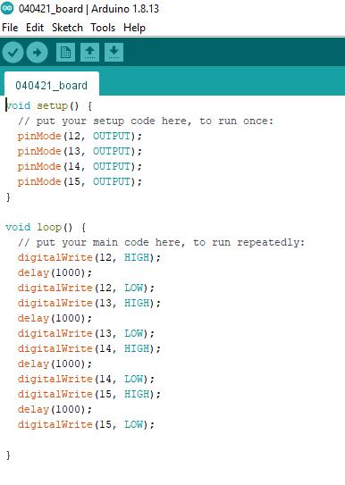
ELECTRICAL
ARDUINO WORK
04/09/21
Raha Riazati
Accomplished tasks
downloaded Arduino software
read through descriptions of basic Arduino functions (digitalWrite, pinMode) and overlap functions with C++ (if, do...while, etc.)
very basic outline of phase transition circuit
Arduino digital output only goes up to 5 V? analogWrite?
How much delay?

Slide 2
ELECTRICAL
Schedule, Next Steps, Budget
04/09/21
Raha Riazati
Budget
Little to no cost given many team members have an Arduino (need to figure out which one)
Schedule
Week 2 – Continue to program phase transitions
Week 3-5 – Operational mode programming involving the LED
Week 6-7 – Test design and optimize further
Week 8-10 - Implement more advanced designs/controls if desired
Next Steps
Learn more about phase transition mechanism (timing, voltage, etc.) to incorporate into design

